Slide 1
SECURE DATA HIDING IN IMAGES USING STEGANOGRAPHY
CAPSTONE PROJECT
Presented By: PRAVIN MOSES G
Student Name: Pravin Moses G
College Name: Loyola-ICAM College of Engineering and Technology
Department: Information Technology

Slide 2
OUTLINE
Problem Statement
Technology used
Wow factor
End users
Result
Conclusion
Git-hub Link
Future scope

Slide 3
PROBLEM STATEMENT
Sensitive information transmitted over digital channels is vulnerable to interception and unauthorized access. While encryption secures data, it makes the presence of hidden information detectable, increasing the risk of attacks. There is a need for a method that ensures both confidentiality and concealment to protect data from being exposed or compromised.

Slide 4
TECHNOLOGY USED
Programming Language: Python
Libraries & Frameworks:
Pillow – Image processing and manipulation
PyCryptodome – AES encryption and decryption
Tkinter – GUI development for user-friendly interaction
Encryption Technique: AES (Advanced Encryption Standard) with CBC mode
Steganography Technique: Least Significant Bit (LSB) Method
Platform: Windows 11

Slide 5
WOW FACTORS
Dual-layer Security – Combines encryption with steganography, making hidden data undetectable. Ensures both confidentiality and advanced concealment.
User-Friendly Interface – Simple GUI for non-technical users to encrypt and decrypt messages effortlessly.
Maintains Image Quality – Embeds data with minimal distortion, preserving resolution and color accuracy. Hidden message remains invisible to the naked eye.
Error Handling & Validation – Ensures secure message retrieval by detecting incorrect passcodes or missing inputs.
Advanced Algorithm – Uses LSB (Least Significant Bit) steganography for seamless data hiding. AES encryption ensures strong security before embedding.
Cross-Platform Compatibility – Works on Windows, Linux, and macOS without extensive setup.
Supports Standard Image Formats – Works on any standard image file format (PNG recommended for best results) while maintaining quality.

Slide 6
END USERS
Cybersecurity Professionals – Enhance data protection by combining encryption with steganography.
General Users – Anyone who wants to securely hide and share confidential messages.
Journalists & Activists – Ensures safe communication in sensitive environments.
Corporate Professionals – Protects confidential business information from unauthorized access.
Law Enforcement & Intelligence Agencies – Securely exchange classified data without raising suspicion.
Students & Researchers – Learn and experiment with cryptography and steganography techniques.

Slide 7
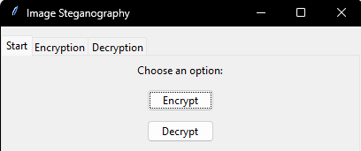
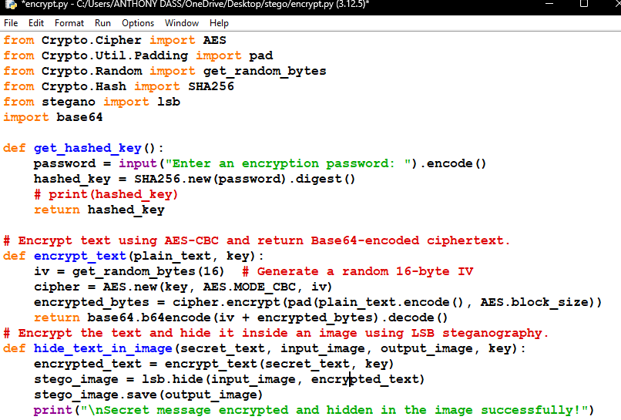
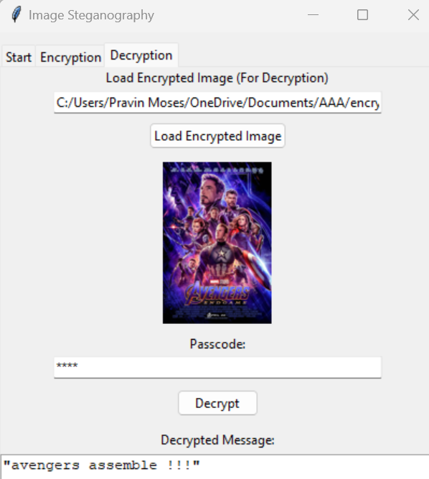

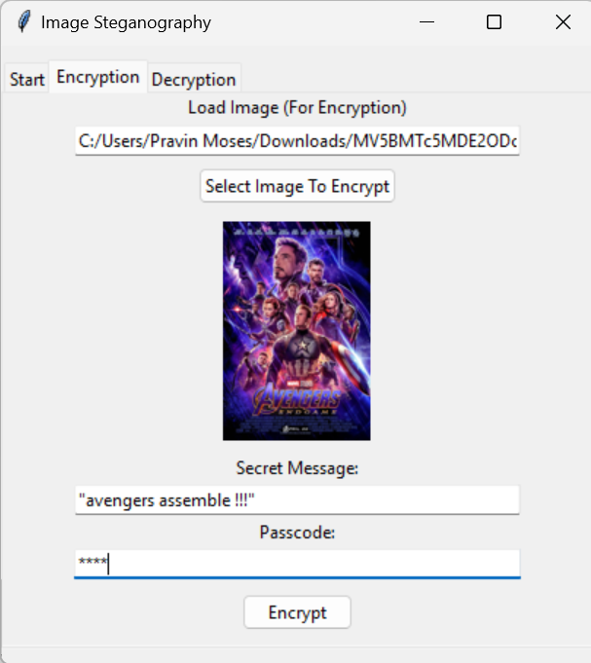
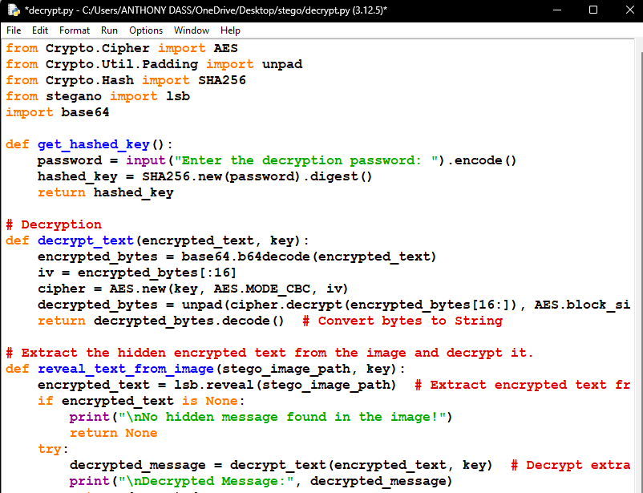
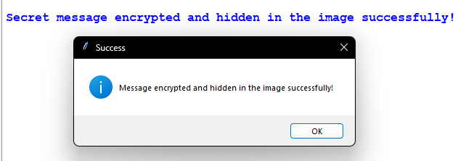
RESULTS
GUI
Decryption Process
Encryption Code
Input Image
Encryption Process
Encrypted Image
Decryption Code

Slide 8
CONCLUSION
This project addresses the challenge of securing sensitive information by integrating encryption with steganography, ensuring both confidentiality and concealment. Unlike traditional encryption, which can attract attention, this method hides data within images, making it undetectable while maintaining the original quality. With a user-friendly interface and robust error handling, it provides a secure and accessible way to transmit confidential messages without raising suspicion.

Slide 9
GITHUB LINK
https://github.com/Pravin-moses/PRAVIN-MOSES-G-Image-Steganography-Using-AES.git

Slide 10
FUTURE SCOPE(OPTIONAL)
Enhanced Steganographic Techniques – Implementing adaptive algorithms to improve data concealment without affecting image quality.
AI-Based Detection Prevention – Using AI to counter steganalysis tools that detect hidden data in images.
Support for Video & Audio Files – Extending the technique to embed messages in videos and audio for wider applications.
Cloud Integration – Enabling secure message embedding and retrieval through cloud-based services.
Stronger Encryption Algorithms – Incorporating advanced encryption methods like AES-256 for enhanced security.
Multi-Layer Encryption – Combining multiple encryption layers for added security before embedding data.

Slide 11
THANK YOU

